Slide 1
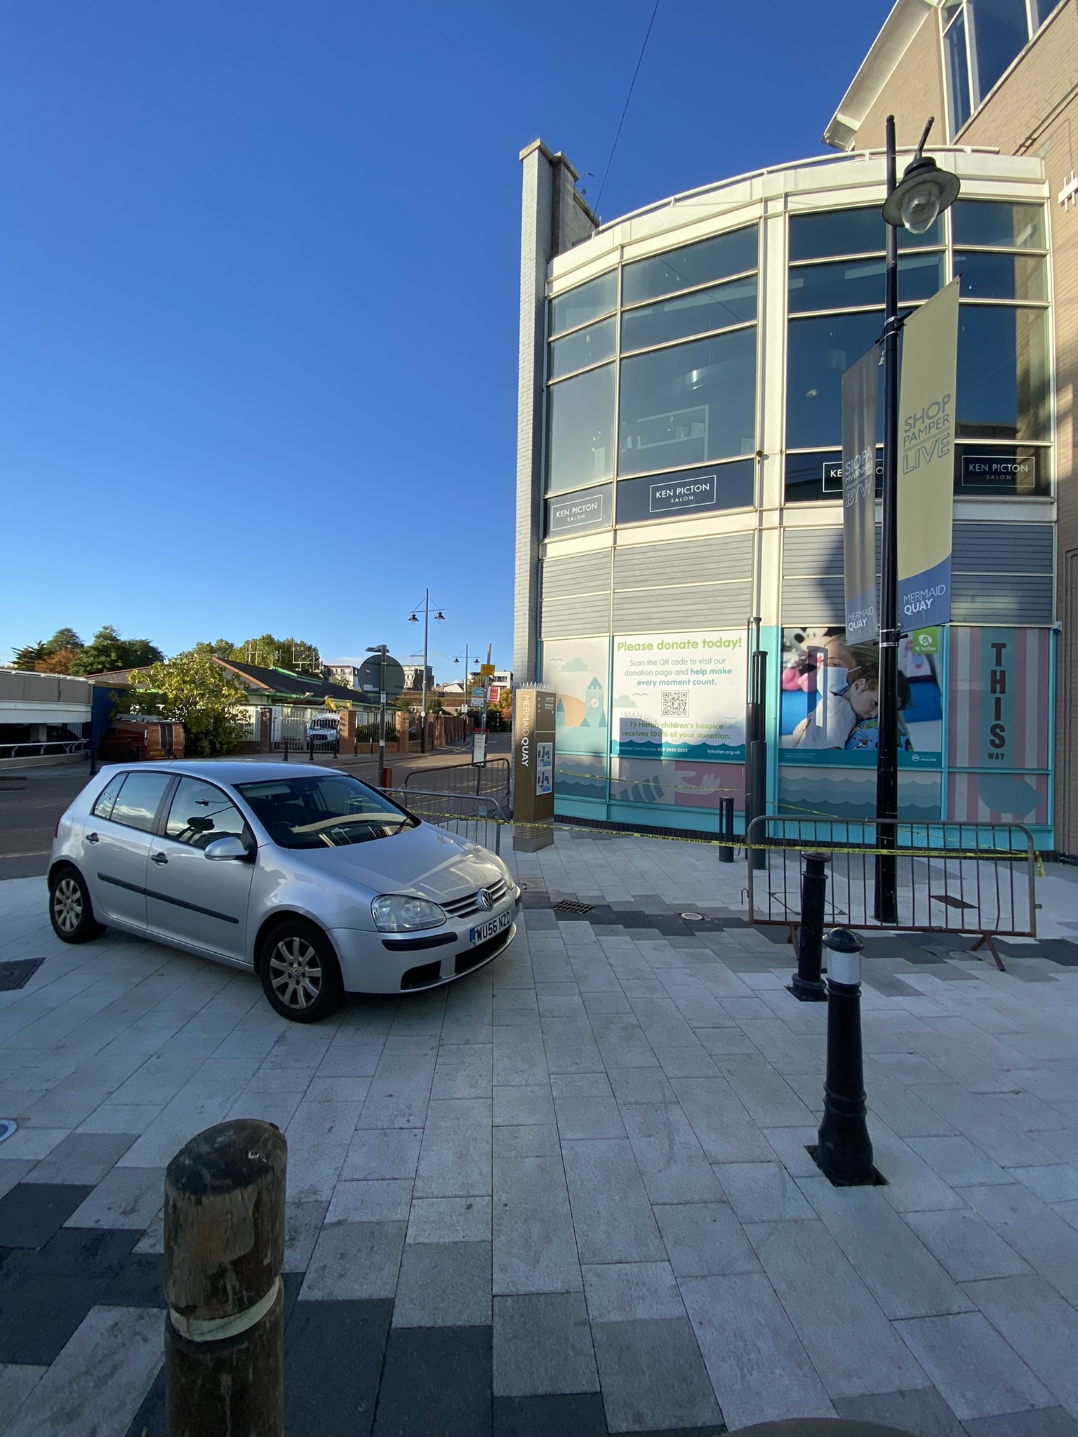
Barriers and tape to cordon off a section of the Quay following a potential crime, investigate to mitigate future crimes. This also shows that police are active in this area, deterring future crime from taking place.
Lighting to ensure visibility at night, which improves comfort of pedestrians and provides better visibility, also deterring crime.
Bollards to exclude large vehicles from entering Quay, and to deter ram raid robberies. This is an extremely easy way to stop large vehicles, as they will physically not be able to get through. It also provides piece of mind to pedestrians that they will not have to worry about larger vehicles passing through, adding to the serenity of a place.

Slide 2
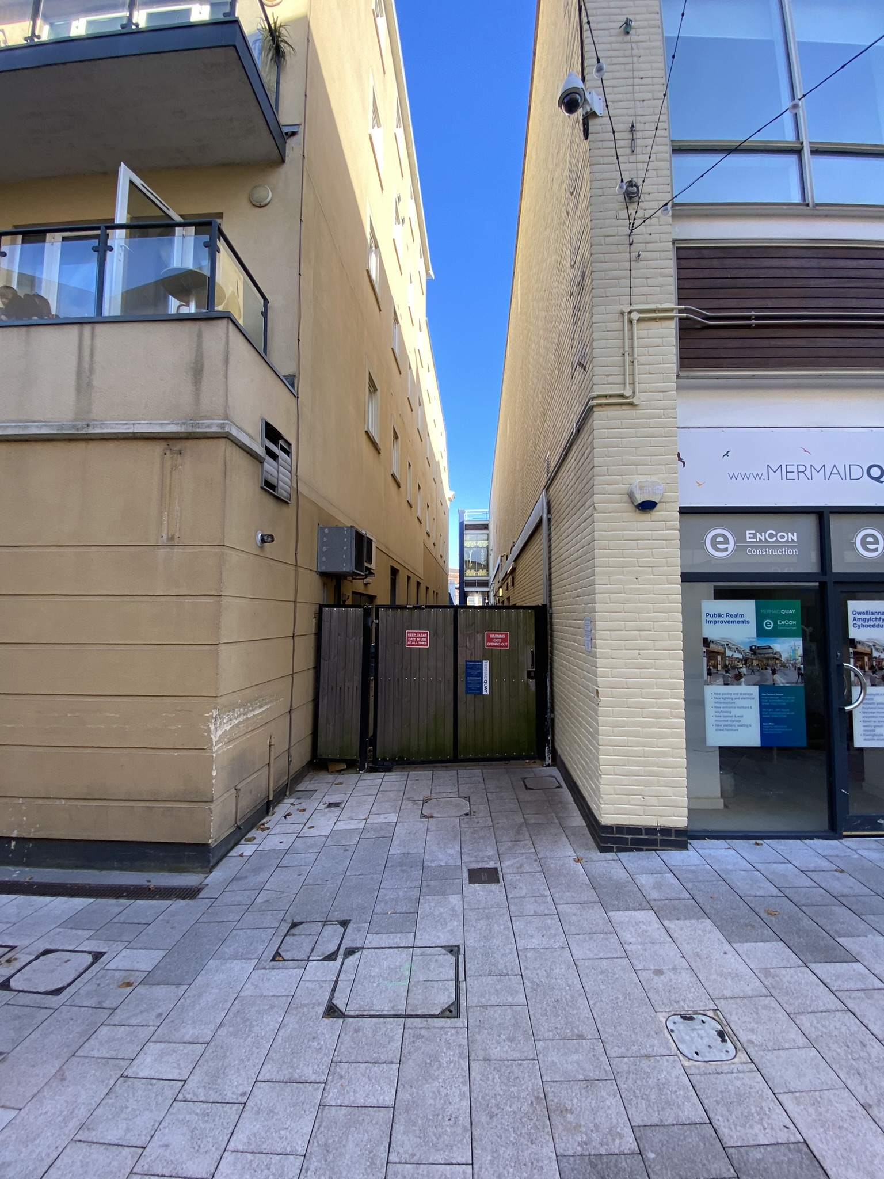
Lighting to improve visibility and deter crime from taking place under the cover of darkness. Similarly to how less crime takes place during the day, less crime will take place in well lit up areas. This is clearly an apartment of some kind, so adequate lighting to allow for residents to see their surroundings is crucial.
CCTV to deter criminal activity taking place and to catch people in the act. Is a very good deterrent for criminals, while a mask can reduce the usefulness of CCTV, it significantly cuts down on spontaneous crime, and will deter premeditated crime too.
Alarm systems to deter criminals from breaking in to buildings. Both acting as a deterrent but also a failsafe should someone break in, alarms are a good way to contact emergency services even when no one is around, with CCTV it must be watched to catch anyone, alarms will work whenever.
Gates and warning signs excluding people from backstreet ally ways, to ensure crime cannot take place in secluded areas and to increase visual appeal of area.

Slide 3
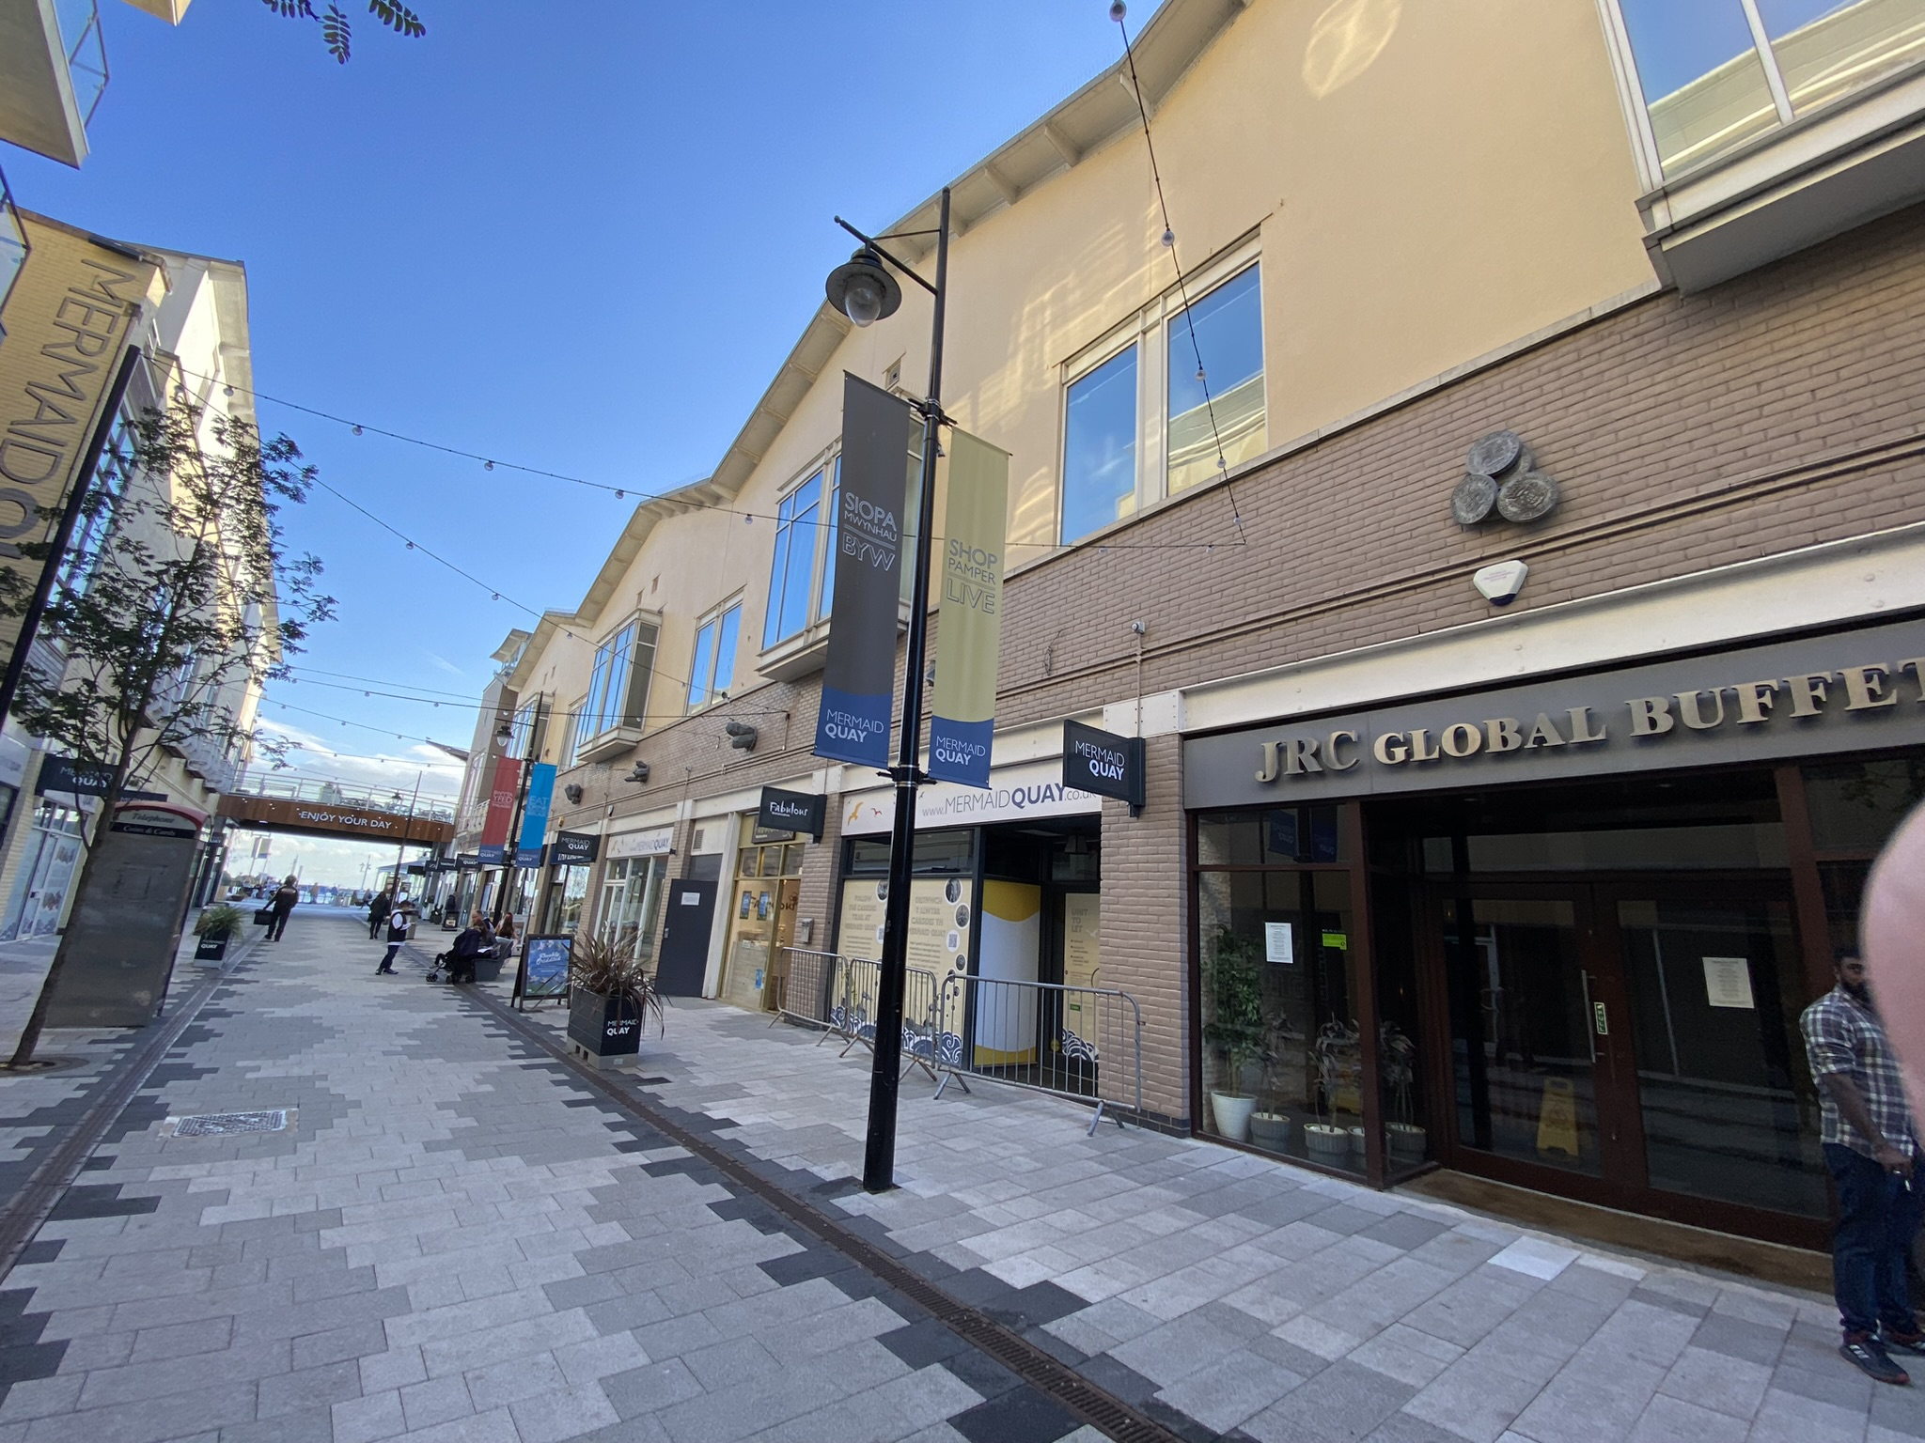
Good lighting to ensure place is lit up during night time.
Friendly lighting to create a relaxed vibe for visitors, lowering levels of stress and in some cases reducing chances of crime.
Alarms acting as an excellent deterrent and good instant failsafe should someone decide to commit a robbery/break in. Instant alert that something isn’t right.
Barriers to exclude people from certain areas following a crime or during renovations.

